Slide 1


Computational Text Analysis:
A Practical Overview
Instructor: Ben Gebre-Medhin
w/ special thanks to Laura Nelson

Slide 2
Goals
Provide a general roadmap of CTA possibilities
Help you understand where to invest your time
To build intuition about various text analysis approaches
Their strengths and limitations
How each works
What kinds of questions they can answer
Provide resources for further exploration

Slide 3
What Do You Want From CTA?
Name, Department
What kind of text data? (if you know)
What sorts of questions? (if you know)

Slide 4
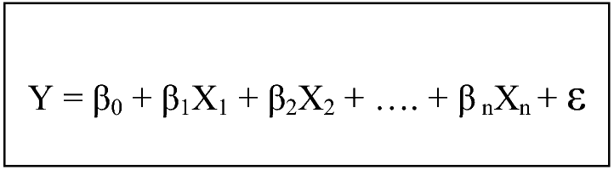
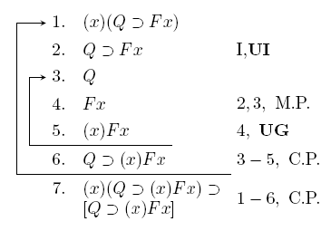
Types of Language
Natural Language
“Time flies like an arrow. Fruit flies like a banana.”
Artificial Language
import scipy
from scipy import sparse
n = 200000
matrix = scipy.sparse.rand(n, n, density=.001)
print matrix
Notes:
Natural versus constructed language
It's difficult to analyze because it's a natural language. Natural languages arise unpremeditated, in the minds of humans. Language people use to communicate with one another. This is opposed to constructed or formal language, e.g. formal logic or computer language. Constructed languages are designed to be completely unambiguous—every symbol is unique and means/produces only one thing, and everyone who learns the language will interpret it the exact same way. Natural languages are ambiguous. The same word can mean different things in different contexts. People use metaphors and complex constructions:
Time flies like an arrow. Fruit flies like a banana.
Even if two people know the same language, they might interpret the same sentence differently.
And it's constantly in flux. Language is changing. One word now may not mean the same thing it did 100 years ago, and may not mean the same thing 100 years from now. For example,
CUTE
Cute was a shortened form of acute, meaning “keenly perceptive and shrewd” in the 1730s.
But by the 1830s it was part of American student slang, meaning “pretty, charming and dainty”.
And, bizarrely, the original sense of “dainty” was “worthy and substantial”. Bank vs. bank?
The problem is meaning. What does natural language mean? What information can we get from it?
It's complicated.
For social scientists and humanists, natural language is often the only data we have. Text, whether
written or transcribed, is everywhere.

Slide 5
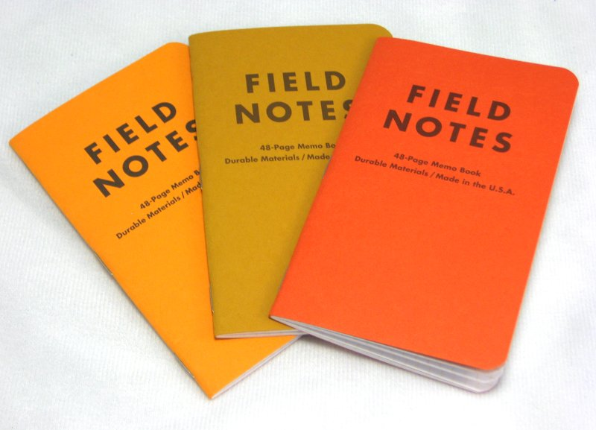
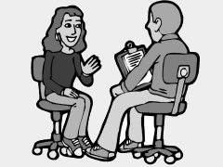
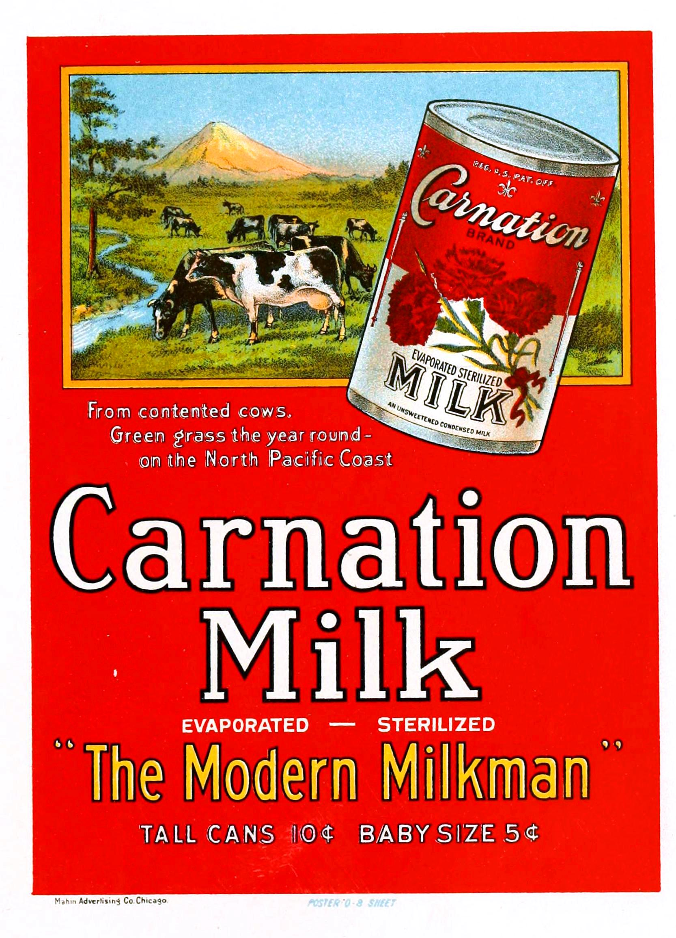

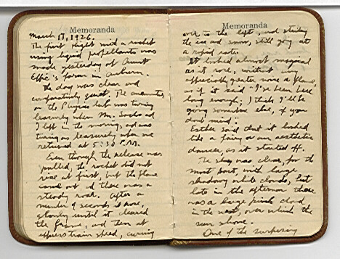


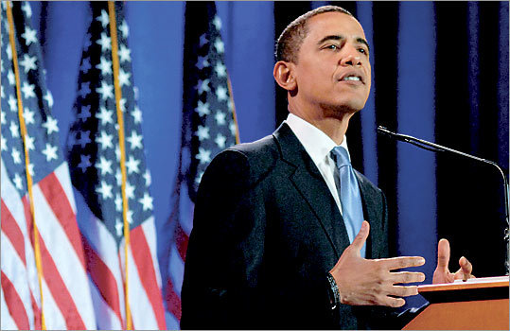
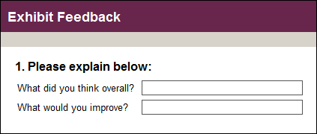
Natural Language as Data
Notes:
Text is a source of data
-Newspapers, political speeches, advertisements, diaries, facebook posts, tweets, interview transcripts, field notes, open ended survey questions. Text is everywhere. It is language, it is culture, it is a record of events, record of opinions, description of people.

Slide 6
Structured vs. Unstructured Data
Legal rulings
Semi-structured interviews
Police Reports
Diary entries
Open-ended survey questions
News reports
Student essays
Letters or emails
Medical forms
Academic journal articles
Notes:
Order these with your partner

Slide 7
What is Structure to a Machine?
?
?
?
?
Notes:
Grammar – SVO?
Proximity -
Sameness –
Difference across corpora
of phonemes/roots; words; N-grams
Fields in a survey or form
Or maybe a by line
A hashtag delimits a topic
An @ symbol delimits a twitter account

Slide 8

How Do Humans Analyze Text?
“We need to steer clear of this poverty of ambition, where people want to drive fancy cars and wear nice clothes and live in nice apartments but don't want to work hard to accomplish these things. Everyone should try to realize their full potential.”
-Barack Obama
Close Reading:
Notes:
We thus must have a way to analyze text.
Types of text analysis
1. Humanists:
-Qualitative, deep/close reading. Seek to answer the question, what does this text mean? What does it tell us about who produced it, and the society in which it was produced?
Pros: Provides context Some say it is the only way to extract meaning
Cons: Time consuming, Dependent on who is doing the reading, non reproducible? (Debates about this), Risk of confirmation bias, cherry picking quotes.
Example: Obama is combining a critique of the American dream with an endorsement of the American dream. He is critiquing the idea that ambition is good, particularly if ambition includes material goods. But he is endorsing the American dream by claiming we should all work hard to realize our full potential. He is couching conservative ideas in liberal terms (poverty of ambition). It is a cunning political strategy.
2. Some humanists, interpretive sociologists, some quantitative sociologists:
-Coding categories. Usually hand coded, or training people to code. Come up with categories, code text in the categories, count occurrences and co-occurrences of categories. John Evans, instrumental and rational action, Ferree, abortion discourse between countries.
Pros: Does take into account context, attempts to capture meaning, but tries to guarantee you're not cherry picking quotes. Purpose to be more objective., Can identify patterns not identifiable but one human reading. Can process much larger amounts of text and reveal patterns across the text.
Cons: Coding can be ambiguous. It's difficult to get two people to code text in the same way, which questions the validity of the project of coding.
Codes: anti material ambition, pro-working hard. Do these show up in other quotes, from other presidents?
3. Political scientists/economists/quantitative sociologists:
-Turn text into numbers, quantify text. Seek to draw variables out of text that can be used in quantitative analysis. Can be word counts, number of words, types of words (part of speech), subject-action-object (Franzosi)
Pros: Does not rely on human interpretation, coding of categories. Researcher is not imposing codes onto the text.
Cons: Completely loses context. Word counts miss ambiguity in meaning, bank (river) and bank (money) will be counted the same. Misses the meaning of the text. Hard to understand what a pattern signifies. More verbs in one text, what does that mean? Do you count verbs, or verbals?
There are
-Categories or words? Words are slightly more straight forward, categories contain more information and more meaning.
-Finally, any of this can be done deductively or inductively
Test for particular patterns, see what patterns arise from the data itself.
The technology to do all this is changing, and methods are changing along with it. Now, we have the ability to a wide range of techniques under the umbrella computer-assisted text analysis. This is what I will discuss. Understanding the debates about text analysis, and different methods, is critical before you can apply computer-assisted text analysis. This is a tool, not a method in itself, you must think carefully about what the text analysis is doing, and what conclusions you can draw from different techniques. This workshop will introduce you to a number of techniques, suggest what types of questions you can answer with different techniques, give you current best practices, and provide you with the tools to use these techniques in your own research by going through some examples.

Slide 9
The promise of “distant reading”
Scale / Speed
Validity
Unburdened by human biases (emotions, theory, assumptions etc)
Read differently (??better??)
See patterns differently
Reliability / Reproducibility
Does not remove the need for interpretation!
Notes:
-Augment humans.
-Humans are slow, can only work limited hours, are expensive because they need to eat. Plus, they are people so you need to treat them well. Pay them well, don't over-work them, etc.
Computers are comparatively cheaper, they work 24 hours a day, you can abuse them. They can do things much faster and much more efficiently than humans.
-Humans are not as reliable. It's remarkably difficult to get them to code text the same way as each other, they often won't code text the same way two different times.
You know exactly what computers are doing, with the same input they will do the exact same thing every time. It's easy to measure accuracy rates. With similar data accuracy will be the same. -Can write down procedure. If someone has your data, coding scheme, and method, they can exactly reproduce what you did. I want to emphasize: that doesn't mean its valid, but it is reliable.
-Replace humans (at first)
Computers read differently than humans, thus they may be able to lead us to different ways of looking at text. Much more memory, can quickly match patterns, are not burdened by experience, emotion, bias. We can use this to our advantage.

Slide 10
Grimmer & Stewart (2013)
All quantitative models of language are wrong—but some are useful
Quantitative methods for text amplify resources and augment humans
There is no globally best method for automated text analysis
Validate, Validate, Validate
Does not remove the need for interpretation!

Slide 11
Choosing a Method
Knowing your options

Slide 12
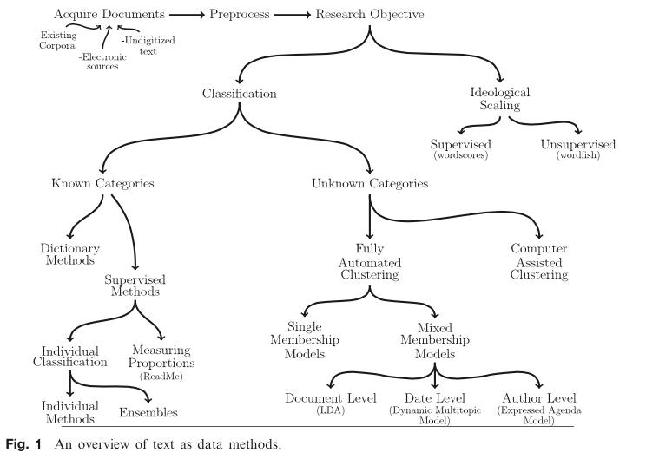
Grimmer & Stewart 2013
Notes:
Grimmer, Justin and Brandon M. Stewart. 2013. “Text as Data: The Promise and Pitfalls of Automatic Content Analysis Methods for Political Texts.” Political Analysis 21(3):267–97.

Slide 13
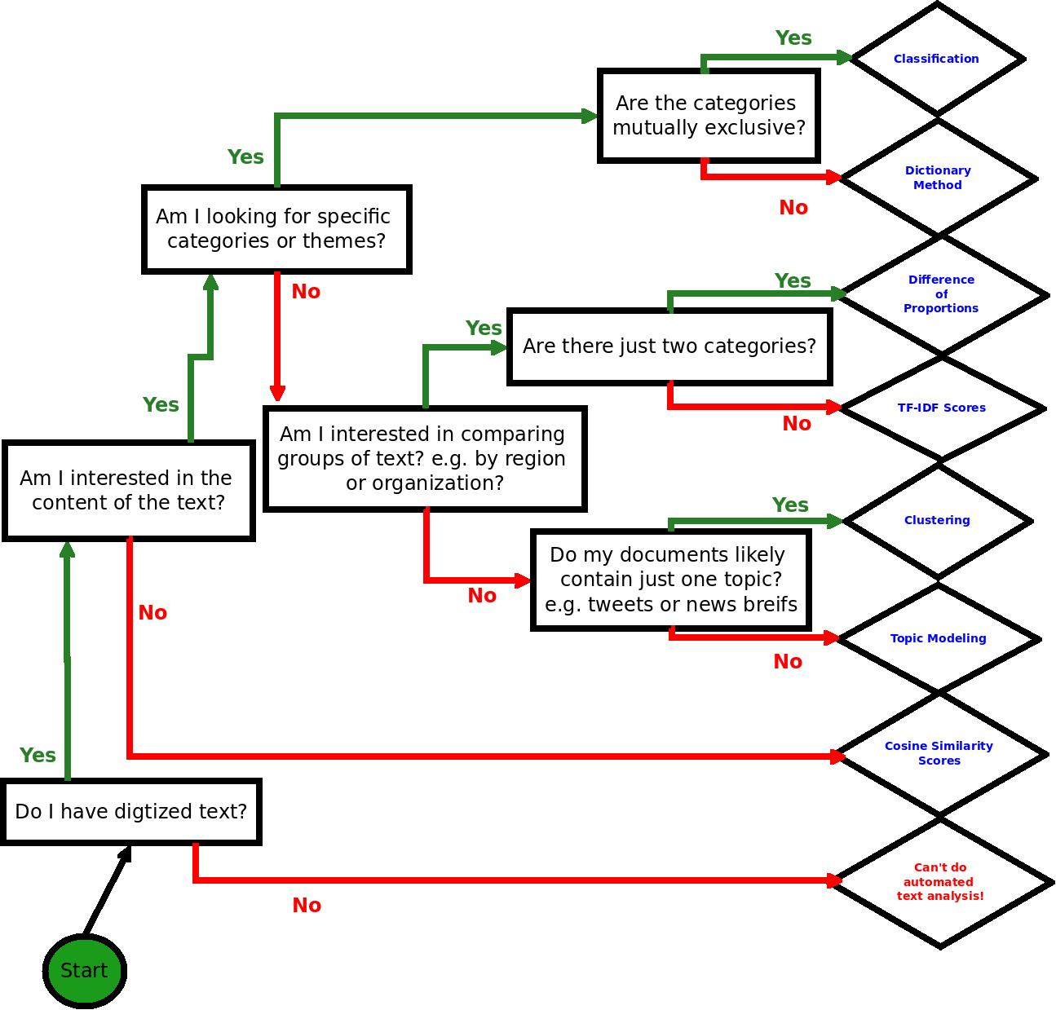
Laura K Nelson
Notes:
Your first decision, can I do automated text analysis? It requires digitized text.
Cosine similarity just checks how similar the corpora are – useful for plagiarism checking. If the number is near zero, someone plagiarized
Second question, do I want to do deductive or inductive analysis?

Slide 14
Some Common Methods
Difference of Proportions
TF-IDF
Dictionary Methods
Supervised Machine learning
Clustering
Topic Modeling
Difference/
Sameness
Classification
at Scale (Known)
Classification at Scale (Unknown)

Slide 15
De-mystifying a Few Terms
Meta-Data: variables about units of text or documents
Corpus: Collection of texts/documents
Lexical: fancy name for word
Matrix: mathematical variant of a table
N-gram
poverty: uni-gram
poverty of: bi-gram
poverty of ambition: tri-gram
Notes:
-Important terms:
Lexical: fancy name for word
Corpus: collection of texts
n-gram: a gram is a word, a uni-gram is one word, a bi-gram is two words, etc.

Slide 16
Acquiring Text
Goal: machine readable text
Pain text (.txt or .csv) file
ATF-8, ASCII
Metadata
Directory of .txt’s or a “tidy” dataset
Cast of Characters – ASCII, ANSI, UTF-8 ttc
Joel Spolsky’s ‘The Absolute Minimum’

Slide 17
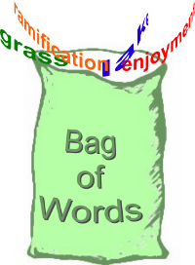
Bag of Words Assumption
Begin here! →
What kind stuff we hav bag?
Notes:
“What kind of stuff do we have in the bag?”
If you are not looking for particular categories or themes, there are ways to inductively explore text. These are fully automated methods. These use a “bag-of-words” approach. The order of the words do not matter, it's just the presence and sometimes co-presence of words within a document that matters. This seems like an extreme assumption, but it turns out if you're looking for themes or topics within a text, this is the best way to do so. Using “bi-grams” or “tri-grams” does not actually add much information.

Slide 18
Pre-Processing: Bagging Words
we need steer clear poverti ambit where peopl want drive fanci car wear nice cloth live nice apart want work hard accomplish thing everyon should tri realiz full potenti
potenti apart
need steer
tri should
we ambit
wear full
nice
Notes:
Pre-processing: common but optional steps (many of the qualitative choices you will have to make to do automated text analysis)
-Remove capitalization
-Remove punctuation and numbers
-Remove stop-words (words that carry little meaning, like it, the, a)
-Stem words
Stemming words is a way to reduce the number of words in your corpus. It combines similar words into one “stem”, similar to reducing words to their root. So machine and machines would count as the same stem. You might not always want to do this. For example, I have a colleague studying the Makers movement. In her case, Make is significantly different from Makers, so she would want to keep them separate.

Slide 19
Pre-Processing
Removed “stop words”
“Stemmed” words to their roots using a Porter stemmer (created by a dude named Porter)
Removed punctuation
Removed upper case
Ready to count how many of each word remains in each document to produce…

Slide 20
Document-Term Matrix
 | ambit | poverti | peopl | full
Document1 Clinton | 40 | 20 | 0 | 10
Document2 Biden | 10 | 30 | 70 | 0
Document3 Warren | 50 | 80 | 90 | 20
Document4 Rand Paul | 90 | 20 | 40 | 10
Document5 Christie | 50 | 20 | 10 | 20
Notes:
After you do this, produce a document-term matrix. Rows are documents, columns are terms, and the cells are the frequency of each term per document. From here, you can do a number of calculations.
Documents = rows
Terms = columns

Slide 21

Questions?

Slide 22
Difference of Proportions
 | ambit | poverti | peopl | full
Clinton | 40 | 20 | 0 | 10
Biden | 10 | 30 | 70 | 0
 | ambit | poverti | peopl | full | Total
Clinton | .57 | .29 | 0 | .14 | 1.0
Biden | .09 | .27 | .64 | 0 | 1.0
Diff of Prop | .48 | .02 | -.64 | .14

Slide 23
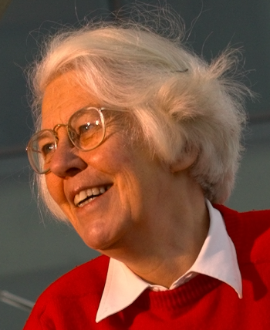
TF-IDF
(c) 1972
term frequency–inverse document frequency, is a numerical statistic that is intended to reflect how important a word is to a document in a collection or corpus. The tf-idf value increases proportionally to the number of times a word appears in the document, but is offset by the frequency of the word in the corpus, which helps to control for the fact that some words are generally more common than others.
Karen Spärck Jones
Notes:
From Geomblog: “Once you think of documents as bags of "terms", you need a way of weighting these terms in a way that allows "similar" documents to have a similar set of weights. Term frequency (TF) is one way of doing this: weight a term with a number proportional to how often it appears. This makes some sense; a document about soccer might use the word 'football' or 'soccer' fairly often, as compared with a document on cricket.” “However, words like 'a', 'an' and 'the' also appear very often in a document. How does one prevent these terms from washing away any semantic context one might have ? One idea is to weight the term frequency by something called 'Inverse Document Frequency' (IDF). For a given collection of documents, count in how many documents a fixed term appears. This number is the term's document frequency. Clearly, a term that appears in all documents can't be a useful distinguisher of a document and so the larger this number is, the less relevant the term. Therefore, by multiplying the term frequency by a function inversely related to the document frequency (if p is the fraction of documents a term appears in, the IDF is often set equal to log(1/p)), you get a more accurate estimate of the importance of the term.”
Karen Jones, Prof. of Computers and Information, Cambridge Computer Laboratory
The Lovelace Medal is presented by the British Computer Society to individuals who have made a contribution which is of major significance in the advancement of Information Systems or which adds significantly to the understanding of Information Systems. The Lovelace Medal and associated lecture are named in memory of Ada Lovelace, who was an inspiration to the computer pioneer Charles Babbage.
The ACM have named Karen Spärck Jones the 2007 ACM Athena Lecturer. Athena Awards celebrate women researchers who have made fundamental contributions to Computer Science. The Athena Award is given by ACM-W, the ACM Committee on Women, to nominees from ACM Special Interest Groups, in this case from ACM SIGIR.
The ACM – AAAI Allen Newell Award, sponsored by the Association for Computing Machinery in conjunction with the Association for the Advancement of Artificial Intelligence, was established to honour the memory and achievements of Allen Newell. The award is presented to an individual selected for career contributions that have breadth within Computer Science, or that bridge Computer Science and other disciplines.

Slide 24
TF-IDF
Gives you output as a list of terms ranked by how unique they are to each corpus
Q: How could we know which term are most common across documents?

Slide 25
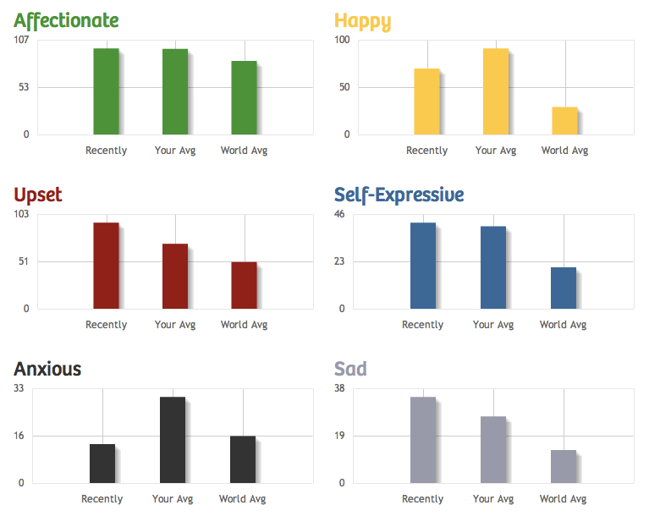
Dictionary Methods
Notes:
This has a long history in content analysis. People will count the number of times words occur in text and use that as a measure of particular topics. Now we can automate it.
Sentiment analysis is a popularly used dictionary method (though it has trouble with the word NOT; with sarcasm; etc.)
This method is particularly good if you think your documents have multiple, overlapping topics or categories. You can determine percent of document per category, rather than assign a document to a category. I.e. this document is 30% anxious and 38% self-expressive
You can use existing dictionaries, like LIWC
Or create your own. You can use WordNet for synonyms to create a fairly comprehensive dictionary for any topic or category.
You need to construct a list of mutually exclusive and exhaustive categories to use classification. Other is okay… but, it helps to have that as a small percentage.

Slide 26
Questions?

Slide 27
Supervised Machine Learning
Start with hand-coding
Train a computer to mimic your hand-coding
We will cover this in the Computational Text Analysis Working Group! Meets every other Wednesday starting 9/21 3:00-5:00 pm
http://dlabctawg.github.io
Notes:
Ben: Could talk about application with haiku

Slide 28
Supervised Machine Learning: Semi-Automated Classification
Label | Document Text | Function
Anti-materialist | Document 1 Text | Training
Pro-hard-work | Document 2 Text | Training
other | Document 3 Text | Training
Pro-hard-work | Document 4 Text | Test
Pro-hard-work | Document 5 Text | Test
Anti-materialist | Document 6 Text | Test
? | Document 7 Text | Unknown
? | Document 8 Text | Unknown
? | Document 9 Text | Unknown
? | Document 10 Text | Unknown
Notes:
You first need to hand-code a set of your documents into mutually exclusive and exhaustive categories. Now you have a coded set, and a non-coded set, which you would like to classify into your categories.
ReadMe: If used properly, ReadMe will report, normally within sampling error of the truth, the proportion of documents within each of the given categories among those not hand coded. ReadMe computes quantities of interest to the scientific community based on the distribution within categories but does so by skipping the more error prone intermediate step of classifing individual documents. Other procedures are also included to make processing text easy.
Or, R: RtextTools, which classifies individual documents.
Move to example, then end of day 1.

Slide 29
Supervised Machine Learning Analyzing Classification Output
____true positives________
precision = true positives + false positives
recall = ___true positives_______
true positives + false negatives
Ex: An algorithm labels 30 words from a TEST document with a ‘generous’ label. 20 of those words were about ‘generosity.’ The algorithm failed to recognize 40 other instances of words that about ‘generosity.’ What is the algorithm’s precision; it’s recall? Is it ready to unleash on unlabeled documents?
Notes:
Precision = how many false positives did your algorithm avoid?
Recall= how many false negatives did your algorithm avoid?
its precision is 20/30 = 2/3 while its recall is 20/60 = 1/3.

Slide 30
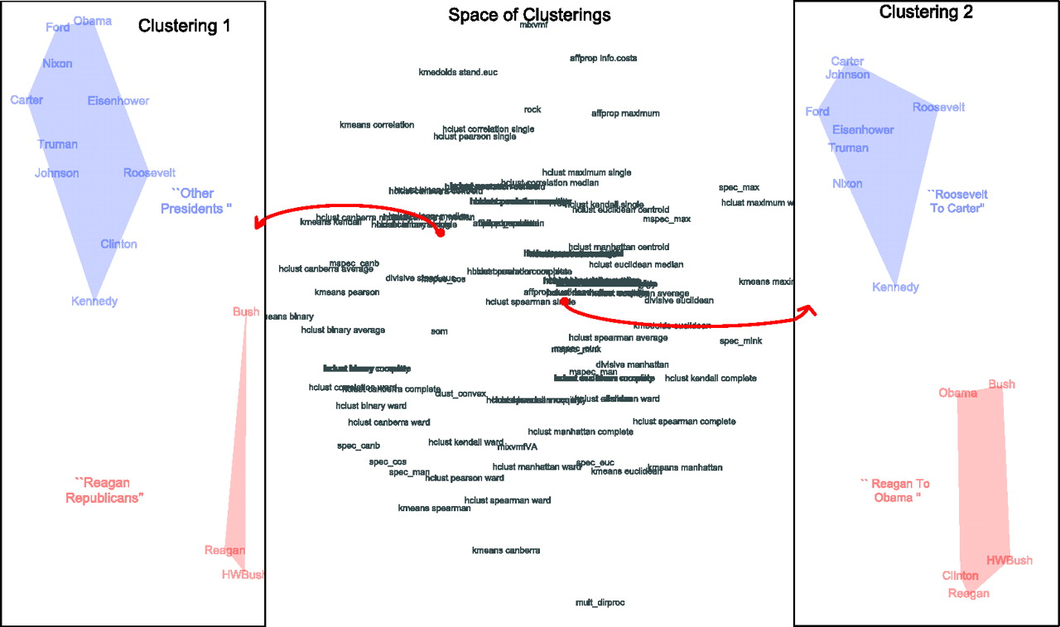
Latent Categorical Analysis
Proximity determined by various algorithms
Notes:
HUNDREDS of algorithms! No “right” answers! The upside?! No “wrong” answers either! :D
This is a way of reducing complicated text. Computer-assisted methods of text analysis seek to reduce a collection of texts, called a corpus, to its underlying structure. These methods are similar in intuition to more commonly known quantitative methods such as multiple correspondence analysis (MCA), factor analysis, and multi-dimensional scaling (MDS).
In text analysis individual data points (à la MDS and MCA), or variables ( à la PCA and factor analysis) are words. Different algorithms and mathematical operations reduce the large and complicated “dataset” (the corpus) to groups of “data points” or “variables” (words) that, when interpreted, can indicate the underlying structure of a text. Just as MCA and MDS use statistical and visual methods to reveal groupings of variables or data points that are impossible for a researcher to identify, automated text analysis approaches reveal latent categories, or groupings of words, within texts. These categories can suggest the underlying structure of diverse or seemingly unconnected texts.

Slide 31
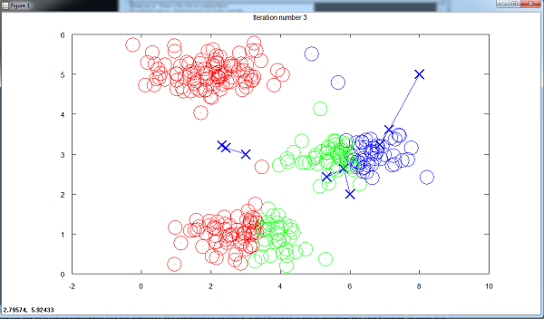
Clustering
Each circle a tweet
Notes:
If you think each of your documents have just one topic or theme, as if often the case with shorter documents like tweets or press releases, then you want to do clustering.
Examples of clusters. Look at the words, or the content of documents in those clusters, to figure out what each cluster is. Here, documents get clustered.
*You choose the number of clusters, it starts with a random center for each cluster. If the number of clusters is bad, or the random start is bad, your clusters will be poor. Do each number of clusters a few times, and ALWAYS VALIDATE YOUR CLUSTERS USING SOME OTHER METHOD!
If you want to allow many topics per document, then do topic modeling.

Slide 32
How Clustering Works
[watch K-means clustering video on youtube to acquire intuition about EM algorithms]
[Start at 2:05]
http://youtu.be/Pxhp1OhEZFc?t=2m5s

Slide 33
Clustering v. Topic Modeling
Clustering
Topic Modeling
These algorithms cluster documents according to the document-term matrix such that each cluster is based on the document similarity.
These algorithms discover “topics” of similar “terms” appearing within “documents.” Then, users can see how terms constitute topics and how topics constitute documents.

Slide 34
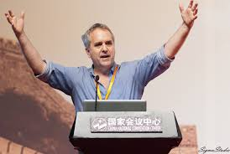
Topic Modelling
Latent Dirichlet allocation. D. M. Blei, A. Y. Ng, and M. I. Jordan. Journal of Machine Learning Research, 3, 993-1022, 2003.
Michael I. Jordan
UC Berkeley CS

Slide 35
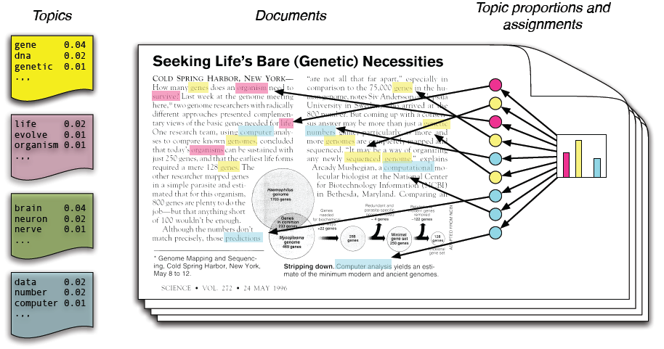
Latent Dirichlet Allocation
Notes:
Most common algorithm: LDA
--Assumes that documents are “structured” from an unknown number of topics. You want to identify the topics from which a document is structured, reverse engineer the document into topics.
Out of a document-term matrix you give a topic modeling algorithm the number of topics you want to find, and it give you two things:
-A distribution of each topic over all of the words (every topic contains every word, at different weights)
-A distribution of each document over all of the topics (every document “contains” every topic, at different weights)
You can then look at how the topic weights per document change over time, or if they're different per category of interest.
-Example from Laura’s work

Slide 36
Topic Modeling
It does:
Allow categories/topics to arise inductively
Find latent topics
Find patterns across documents
Handle large and diverse corpora
Find key differences between topics
It does not:
Find the “one” best way to categorize text
Capture the categories you want
Tell you who does what to whom, etc.
Magically reveal meaning
Notes:
7. Topic modeling
People have a lot of misconceptions about topic modeling. What you should know:
What topic modeling can do:
BE SURE TO NOTE THAT DOCS can be defined as sentences, paragraphs, etc.
It allows categories to arise inductively from text, removing the need to artificially impose a structure on the text prior to analyzing the text itself.
Similarly, it can be used to discover patterns across text, or categories within text, that you may not be considering or may not be immediately available to a human reader. Topic modeling should be used to uncover latent categories within text to advance our understanding of what the text means and what it says about the social world that created it. Often surprising but analytically useful categories may be revealed.
It can deal with large and diverse corpuses that you as a researcher are struggling to make sense of.
It can help identify key differences between the topics addressed in different texts, or can identify how topical focus changes over time.
What topic modeling can not do:
Topic modeling does not find the “one”, only, or “best” way to categorize text. There are hundreds of topic modeling algorithms each producing different word clusters, and within each algorithm varying the number of topics produces different word clusters, ultimately allowing close to infinite ways to categorize text. This method works if it reveals new or productive patterns in the text that will help you understand the phenomenon of interest, not by objectively or definitively categorizing text.
It does not work if you already have categories in mind. To use an empirical example, in his recent article published in Mobilization, Alex Hanna analyzed whether posts on a political Facebook group wall dealt specifically with different types of mobilization efforts (“Computer-Aided Content Analysis of Digitally Enabled Movements” 18(4): 367-388, 2013). Because he had specific categories in mind topic modeling would have been entirely unhelpful. Instead, he correctly chose a supervised machine learning approach where he had control of the categories into which texts were classified, allowing him to directly answer his question.
It does not determine who does what to whom. If you’re interested in this type of question you’ll need a language model that does incorporate grammar.
It does not reveal statistical differences between texts or categories. Other methods are needed to do this.
It definitely will not magically help us understand the black box of culture. It’s science, not magic, and any science takes work.

Slide 37
A Practical Example

Slide 38
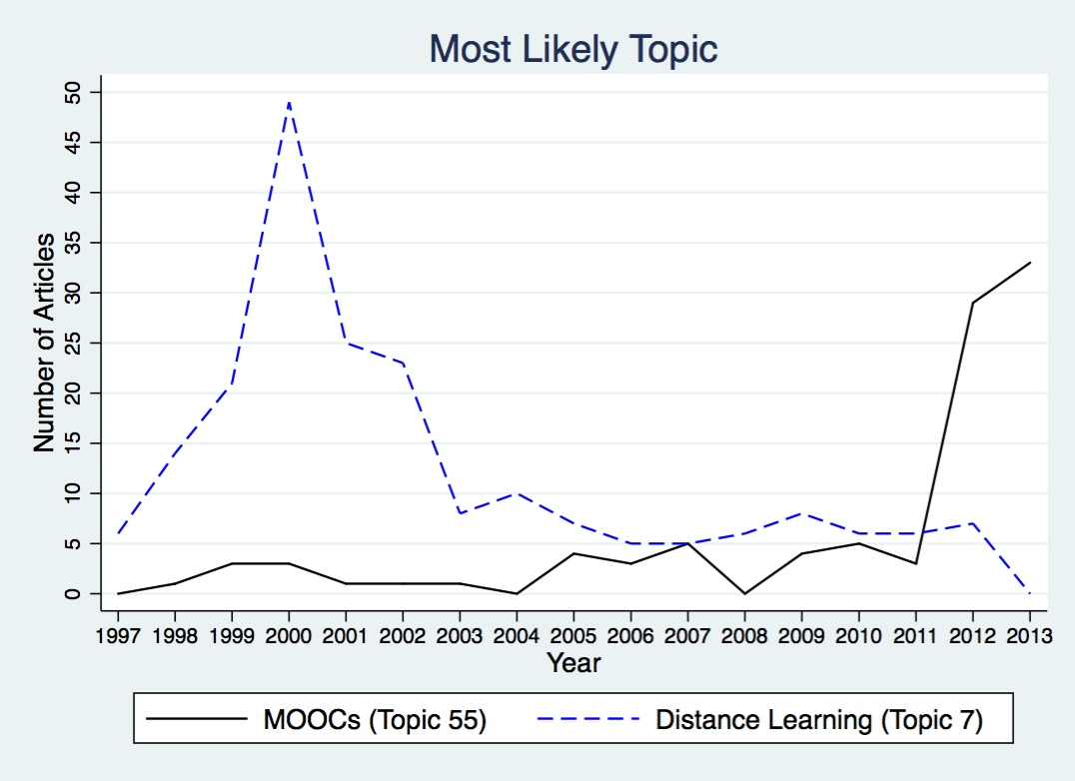
Two Waves, Two Frames
MOOC Frame
Distance Education Frame

Slide 39
Two Waves of Online Higher Ed
Distance Education Frame
MOOC Frame
1998-2002 (peak in 2000)
Closely associated with states that have extensive higher education systems
Focus on content
Spiked in 2012, and increased again in 2013
Closely associated with data, measurement, and testing (analytics)
Focus on platform

Slide 40
Two Axes of Comparison
Internet Course Delivery in Higher Ed
2nd Axis - Regional
1st Axis -
Historical
Cambridge
Bay Area
Platforms & MOOCs
Expansion of Distance Ed

Slide 41
Two Axes of Comparison
Internet Course Delivery in Higher Ed
2nd Axis - Regional
1st Axis -
Historical
Platforms & MOOCs
Expansion of Distance Ed
Bay Area
Cambridge

Slide 42
Hand Coding V. Topic Modeling
 | Hand Coding | Topic Modeling
Selecting Articles | Sample or find small populations | Broadly inclusive
Sample size limit | Human resources | Computational resources
Coding scheme | Expert derived | Computer derived
Assumptions | Categories are exclusive | Categories overlap (topics & words)
Reliability | Heavy burden of specification (opaque) | Managed by software (clear choices?)
Validity | Trust the expert | Trust the machine
How to verify | Show smaller sample | Read/hand code smaller sample

Slide 43
Search Terms
Terms | Results
online or internet or web | 12,300
course or courses or class or courseware or credential or degree | 6,712
Articles with any one of the first search terms, AND any one of the second were included in the analysis.

Slide 44
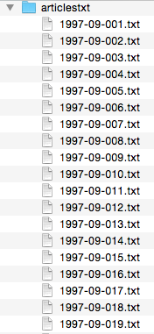
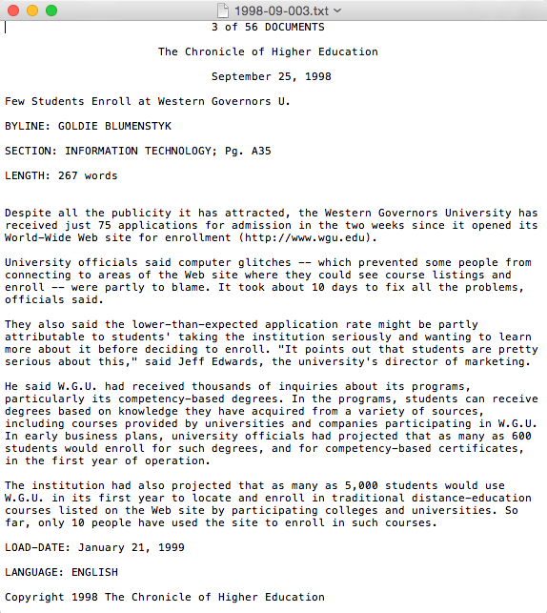
The Articles

Slide 45
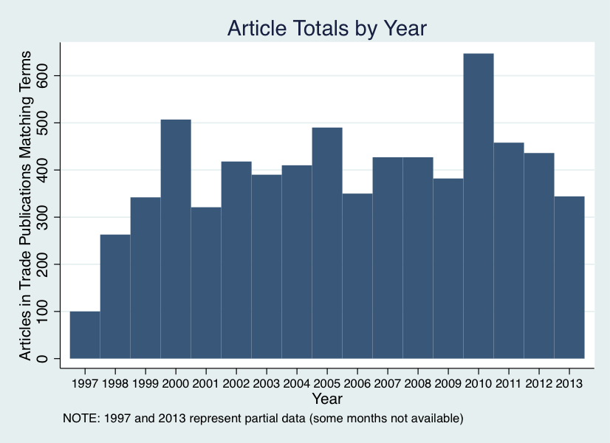

Slide 46
Article Pre-Processing (mostly in R)
Removed | Kept
-Metadata -title, byline, word count, etc. -Common stop-words -Punctuation -Extra white spaces | -Sparse terms -Full Words (un-stemmed)
(Following DiMaggio, Nag, and Blei 2013)

Slide 49
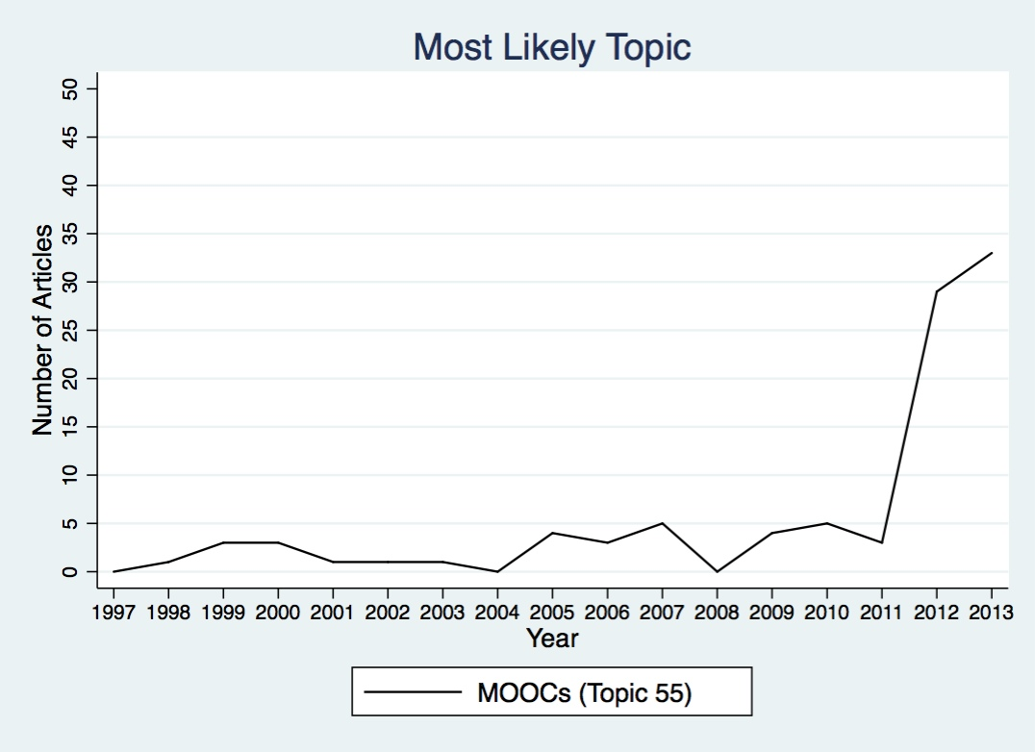

Slide 52
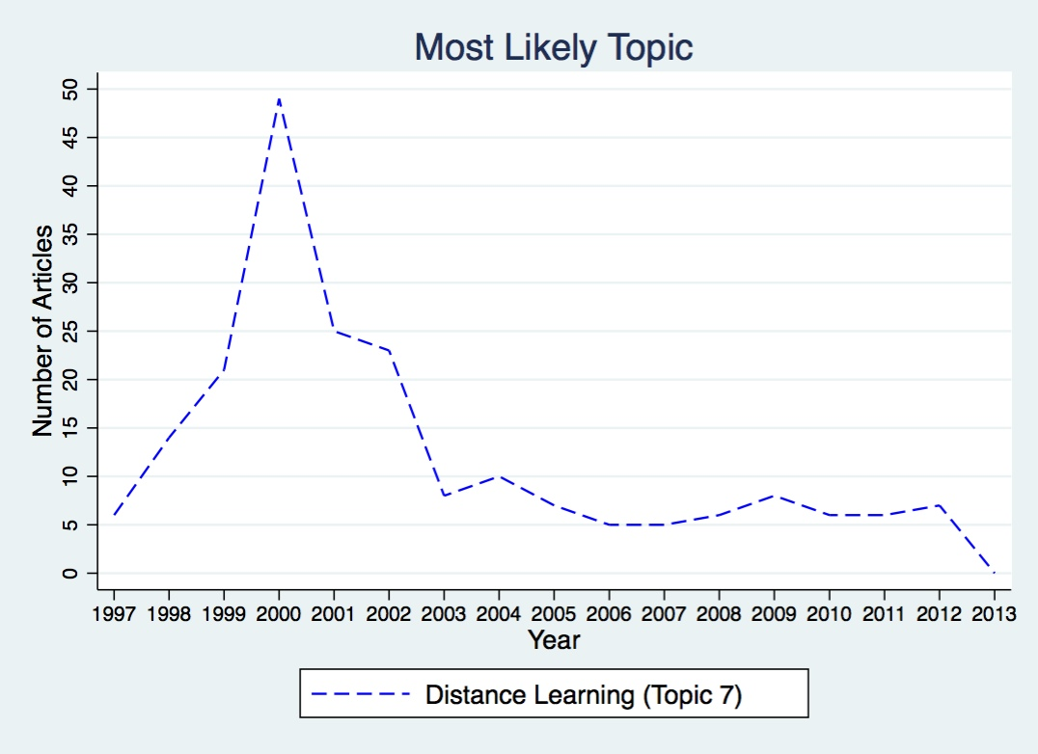

Slide 54
Two Waves of Online Higher Ed
Distance Education Frame
MOOC Frame
1998-2002 (peak in 2000)
Closely associated with states that have extensive higher education systems
Focus on content
Spiked in 2012, and increased again in 2013
Closely associated with data, measurement, and testing (analytics)
Focus on platform

Slide 55
Conclusion:
Computers can help, but…
Still requires informed human choices
Which method? Stem words? Remove stop words? Which stop words? Remove frequent/infrequent words? How many clusters? How many topics?
CTA will not do the interpretive work for you!
Matching question to method is complicated and key
Methods can be combined for nuance and complexity
In CTA, and machine learning, think randomness
Don’t assume faithful reproducibility
Validate, validate, validate!

Slide 56
Thanks! Next Steps at the D-Lab
Computational Text Analysis Communities
CTWAG (CTA Working Group)
Digital Humanities Working Group
D-Lab Consulting
Future technical trainings
D-Lab: http://dlab.berkeley.edu
CTAWG: http://dlabctawg.github.io

Slide 57
End
Extra Slides

